Slide 1

IIS Company
Computer Network CCNA, Group 1
Instructor: Esraa Saadeh
Student: Mahmoud Sabobeh
Notes:
We designed this template so that each member of the project team has a set of slides with its own theme. Members, here’s how you add a new slide to just your set:
Mark where you want to add the slide: Select an existing one in the Thumbnails pane, click the New Slide button, then choose a layout. The new slide gets the same theme as the other slides in your set.
Careful! Don’t annoy your fellow presenters by accidentally changing their themes. That can happen if you choose a different theme from the Design tab, which changes all of the slides in the presentation to that look.

Slide 2
Topics
Objective
Steps
Tools
Topology
Protocols
Budget
Conclusion

Slide 3
Objective

Slide 4
Steps
1
Planning
3
Testing
4
Maintenance
2 Implementation
5
Final project

Slide 5
Tools
Packet Tracer Cisco
IP Subnet Calculator (website)

Slide 6
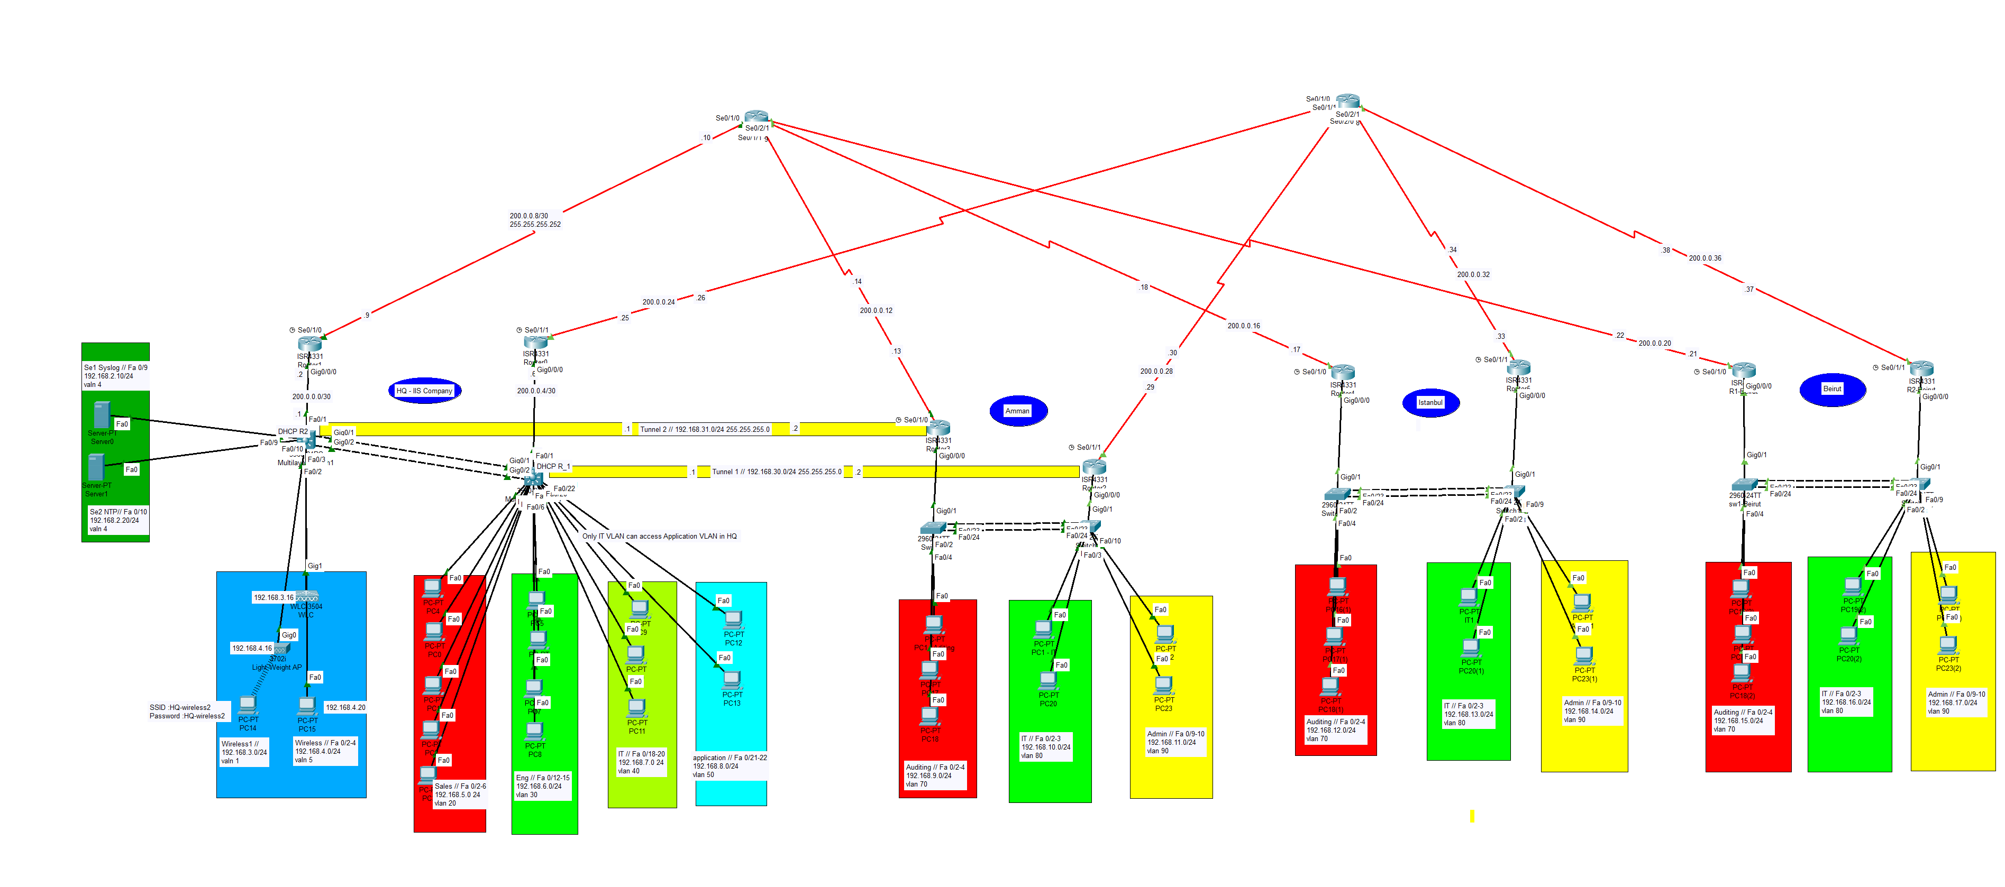
Topology

Slide 7
Protocols
OSPF
DHCP
HSRP
Syslog
NTP
GRE (VPN)

Slide 8
Budget
No. of Pieces | Pieces / Devices | Price (USD) / 1 Piece | Total (USD)
6 | 2960 Switch 24 Ports /2 GB | 2500 | 15.000
2 | 3560 Multilayer Switch | 3500 | 7.000
10 | ISR4331 Router | 1500 | 15.000
12 | High Wan Interface Card (HWIk) | 1000 | 12.000
2 | Workstation/Server | 600 | 1.200
1 | WLC 3504 | 5000 | 5000
1 | Light weight AP | 300 | 300
1 | Wireless adapter | 50 | 50
 |  |  | Total: 55.550 Budget: 85.000

Slide 9

The End
mahmoud.sabobeh@hotmail.com

